Slide 1
Self-Sovereign Identity
Own your digital identity!

Slide 2
Why We Chose Digital Identity
It’s a prerequisite for most digital applications.
Has a wide range of use cases in our day-to-day life.
It directly impacts our security and privacy.
Identity and Access Management (IAM) industry has 8 billion dollars estimated size.

Slide 3
Example Case
We want to create a system where the employer can verify that applicants have a valid diploma issued by a university.

Slide 4




Vocabulary
Credential: Set of claims/assertions made about holder. (Diploma)
Holder: The entity which claims are made about.
Issuer: The entity asserting claims about owner.
Verifier: The entity evaluating whether a claim about a given holder is authentic.

Slide 5
Previous Digital Identity Models
Digital identity models prior to Self-Sovereign Identity

Slide 6
Centralized Identity
Issuers manages the credentials in their own system.
Private (direct communication between the verifiers and the issuers)
Not standardized (verifiers need to have a separate protocol for each issuer they want to interact with)
Uncontrollable (issuers have the complete control over the holder's credentials)

Slide 7

Third-Party Identity
Third parties manage the credentials given by issuers.
Standardized (verifier can interact with many issuers through a single system)
Not private (third parties can collect private information)
Uncontrollable (third parties have complete control over the holder's credentials)

Slide 8
Self-Sovereign Identity (SSI)
System that is private, standardized and controllable all at the same time.

Slide 9
Standard Terms for SSI
Decentralized Identifier (DID): Identifiers with a blockchain address and public private key pair tied to it.
DID Document: Documents that are stored in the blockchain which has a DID, corresponding public key and a URL to interact with the identity owner.
Wallet: Applications where the private keys and verifiable credentials are stored.
Verifiable Credentials: Interoperable, cryptographically-verifiable digital credentials.
Decentralized Key Management System (DKMS): Systems that store and manage private keys inside a wallet across devices. Enables key synchronization and recovery.
Trust Hubs: Trust hubs are registries keeping the list of trustworthy entities They are usually managed by the wallet application creators.

Slide 10
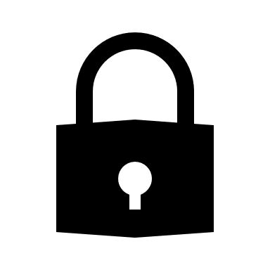
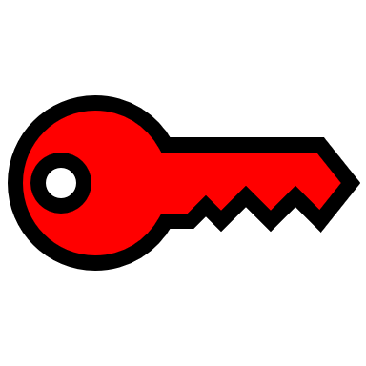
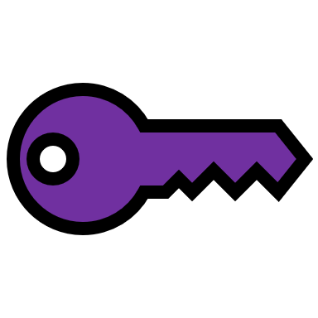
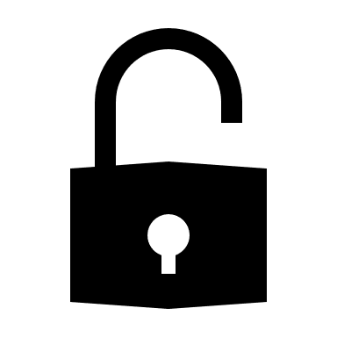

Employer’s Wallet
DID: 1111
URL: employer.com
Alumni’s Wallet
DID: 2222
URL: alumni.com
University’s Wallet
DID: 3333
URL: university.com
Diploma
Name: Etka Tutkun
Issued DID: 2222
Issuer DID: 3333
Signature: aBcD
Diploma
Name: Etka Tutkun
Issued DID: 2222
Issuer DID: 3333
Signature: aBcD
VERIFIED
Apply to position with DID 2222
Request a diploma issued to DID 2222
Private
Apply to get registered to Trust Hub
Apply to get registered to Trust Hub
Private
Private
Check DID
Owner Name
Connection Established
Connection Established
Trust Hub
(Managed by a well-known organization)
1111 –> Employer
3333 -> University
Check DID
Owner Name
Blockchain
DID: 1111
URL: employer.com
DID: 2222
URL: alumni.com
DID: 3333
URL: university.com
Public
Public
TRUSTED
Public
Public
Public
Public
TRUSTED

Slide 11
Benefits of SSI
Private: Direct communication between holders, issuers and verifiers.
Standardized: Many holders, issuers and verifiers can interact through a single system.
Controllable: Holders have complete control over their credentials.
Blockchain

Slide 12
The Problem
As we mentioned trust hubs are registries keeping the list of trustworthy entities. They provide us a way to identify the real owner of a DID.
However, as you can see in the standard workflow this introduces the problem of centralization of trust. Entities need to trust to the maintainer of the trust hub server without any alternatives.
Usually, maintainer of these servers are the creators of the wallet applications which entities uses to interact with the system. And the decision of trust is prebuilt into these applications without giving any options to the entities.

Slide 13
Proposed Model
To solve this problem, we are suggesting a system where entities can create trust relationships by providing well-known credentials they got from different well-known issuers.
This will allow entities to trust any well-known issuer they choose without forcing them to trust a single organization. Providing multiple alternatives to entities removes the centralization point from the system.

Slide 14
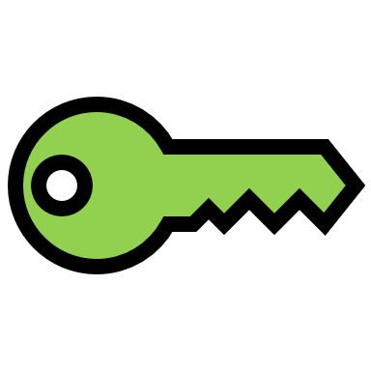

Employer’s Wallet
DID: 1111
URL: employer.com
Alumni’s Wallet
DID: 2222
URL: alumni.com
University’s Wallet
DID: 3333
URL: university.com
Diploma
Name: Etka Tutkun
Issued DID: 2222
Issuer DID: 3333
Signature: aBcD
Well-Known Credential
Name: University
Issued DID: 3333
Issuer DID: 6666
Signature: IjKL
Diploma
Name: Etka Tutkun
Issued DID: 2222
Issuer DID: 3333
Signature: aBcD
Well-Known Credential
Name: Employer
Issued DID: 1111
Issuer DID: 5555
Signature: eFgH
Trusted DIDs
5555
6666
VERIFIED
Apply to position with DID 2222
TRUSTED
Trusted DIDs
4444
6666
TRUSTED
Apply for well-known credential with DID 1111
Apply for well-known credential with DID 3333
Private
Private
Private
Connection Established
Connection Established
Well-Known Credential
Name: Employer
Issued DID: 1111
Issuer DID: 5555
Signature: eFgH
Well-Known Org1
DID: 4444
Blockchain
Well-Known Org2
DID: 5555
DID: 5555
URL: org2.com
DID: 6666
URL: org3.com
DID: 1111
URL: employer.com
DID: 2222
URL: alumni.com
DID: 3333
URL: university.com
Public
Public
Public
Public
Public
Public
Public
Public
Well-Known Credential
Name: University
Issued DID: 3333
Issuer DID: 6666
Signature: IjKL
Well-Known Org3
DID: 6666

Slide 15
We have created a system where an entity can create private identity relationships with any other entity through a standard protocol without depending on a centralized authority.

Slide 16
Thank you for listening…
Halil Etka Tutkun - 21627711

